Slide 1
Infant with HIE and Compromised Systemic Circulation
Yasser El-Sayed

Slide 2
Case history
SL, born at 41 weeks, girl, 4 kg, LGA, delivered by Crash C/S due to absent fetal heart rate
Maternal history
30 y/o primigravida, Serology protective
GBS positive not treated
Thick meconium

Slide 3
Birth history
Flat, apneic, no heart rate
Tracheal intubation – no meconium below the cords
PPV+chest compresion+epinephrine(ET,IV)
AS: 0 at 1 min, 0 at 5 min, 0 at 10 min
Heart rate >100 at 12 minutes

Slide 4
Blood gas
Umbilical artery
pH 7.14, pCO2 69, pO2 37, HCO3 18, BE – 8
1st arterial
pH 6.77, pCO2 79, pO2 46, lactate 22, BE -18
Started cooling protocol
Mechanical ventilation

Slide 5
Blood pressure 1st DOL
Dobutamine 5 7 10
Dopamine 5 7

Slide 6
Oxygenation failure
Due to increased oxygen requirement (up to FIO2 1), OI of 16 started INO on second day of life.
Before TNE
Dobutamine of 20 mcg/kg/min+ Dopamine of 10 mcg/kg/min+ Epinephrine of 1 mcg/kg/min

Slide 7
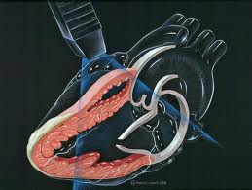
2-3 DOL
Dobutamine 12 20
Dopamine 10
Epinephrine 0.1 0.2 1
Hydrocortisone

Slide 8
4th-5th DOL after intervention
Dobut
Vasopressin 0.0003 – 0.0001
Hydrocortisone
Urine output 4 – 5 ml/kg/day

Slide 9
Evaluation by IENH
TNE
Severe under filling of LV
Low systemic vascular resistance
Pulmonary hypertension (Supra-systemic)
Fractional oxygen extraction=
(Arterial oxygen saturation- venous oxygen saturation)/arterial oxygen saturation
= (95-84)/95= 0.11 (normal= 0.15-0.33)

Slide 10
Evaluation before and after intervention
 | Echo 1 | Echo 2
TR Vmax RVSP | 35 | -
RVET:PAAT | 4.2 | 3.1
TAPSE | 0.45 | 0.78
FAC | 21 | 41
IVS | Flat | Flat
RVO | 78 | 170
LVO | 80 | 155
LV EF | 45 | 67
PV V max | - | Good inflow
SVR | Low (43mmHg/L/kg) | 260 mmHg/L/kg
IVRT | 70 | 60

Slide 11
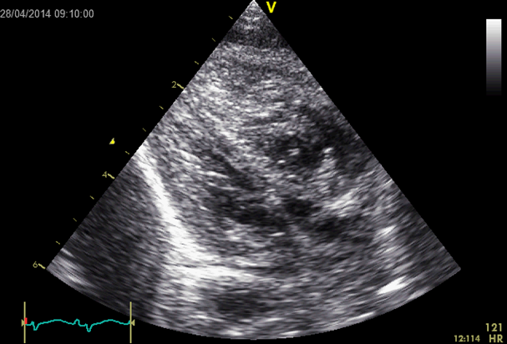
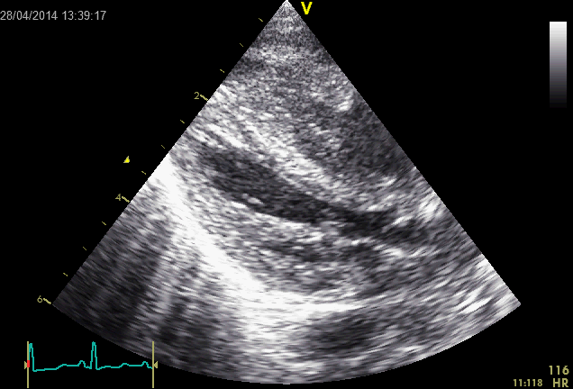
Under filled LV
After 40 ml /kg NS

Slide 12
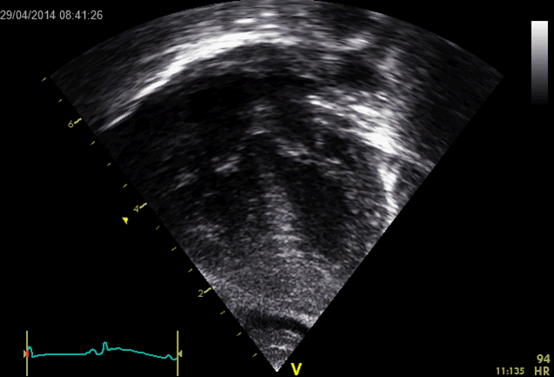
Under filled LV Cavity
After 40 ml /kg NS

Slide 13
Strategy of Management:
Fluid management (fill the tank) given total of 50cc/kg over 4 hours period
Low SVR (Started vasopressin)
Check appropriate response to stress (Cortisol level)
Do not rely on NIRS or oxygen extraction for evaluation of tissue oxygenation in HIE (low oxygen extraction due to brain damage)

Slide 14
Response to interventions
off all cardiovascular medications within 12 hours after start of volume management and vasopressin

Slide 15
Neurologic
Cranial MRI post cooling
Global HIE changes with restricted diffusion in basal ganglia and thalami
EEG/Seizures
1St :Decreased background + seizure
Discharged to home after 4 weeks of admission

